Slide 1


SMART INDIA HACKATHON 2025
Problem Statement ID- 25137
Problem Statement Title-Student Innovation
To develop a software solution to enhance tourism by helping tourists plan trips, discover hidden gems, and support hotels, restaurants, and local businesses.
Theme-Travel and Tourism
PS Category- Software
Team ID-
Team Name-

Slide 2
AI-POWERED INTERACTIVE TRAVEL COMPANION
TechStack
📸 Photo Recognition & Stories Snap a photo →AI reveals historical facts, hidden cultural tales, and nearby related experiences, making each place come alive.
🗓️ Smart Personalized Planner Choose your mood—adventure, relaxation, family, or local-only. AI creates a day-wise itinerary, adapting in real time to weather, crowd levels, and local events.
🚦 Hidden Gems & Live Discovery Uncover less-crowded spots with live feeds and predictive data. Join exclusive experiences, workshops, and connect with local guides and artisans.
🏨 Local Business Integration It connects verified restaurants and shops like jewelry,toy shops etc. directly with tourists enhancing their convenience and experience.
Addresses the Problem:
Simplifies travel journey design for tourists through data-driven guidance
Promotes hidden gems, religious and non-religious attractions, and local culture using APIs and crowd-sourced data.
Empowers hotels, restaurants, and small businesses through digital integration.
Innovation & Uniqueness:
AI-Powered Personalized Experiences: Uses AI to analyze photos and recommend hidden gems and personalized tour routes for authentic local discovery
.
Interactive Quizzes and Leaderboards: Gamifies cultural exploration with knowledge quizzes and leaderboards to engage users and encourage learning.
Real-Time Crowd Management: Provides crowd density tracking and alerts to optimize visitor flow and reduce wait times dynamically.
Multilingual Accessibility: Offers comprehensive multilingual support to welcome and assist travelers from diverse linguistic backgrounds.

Slide 3
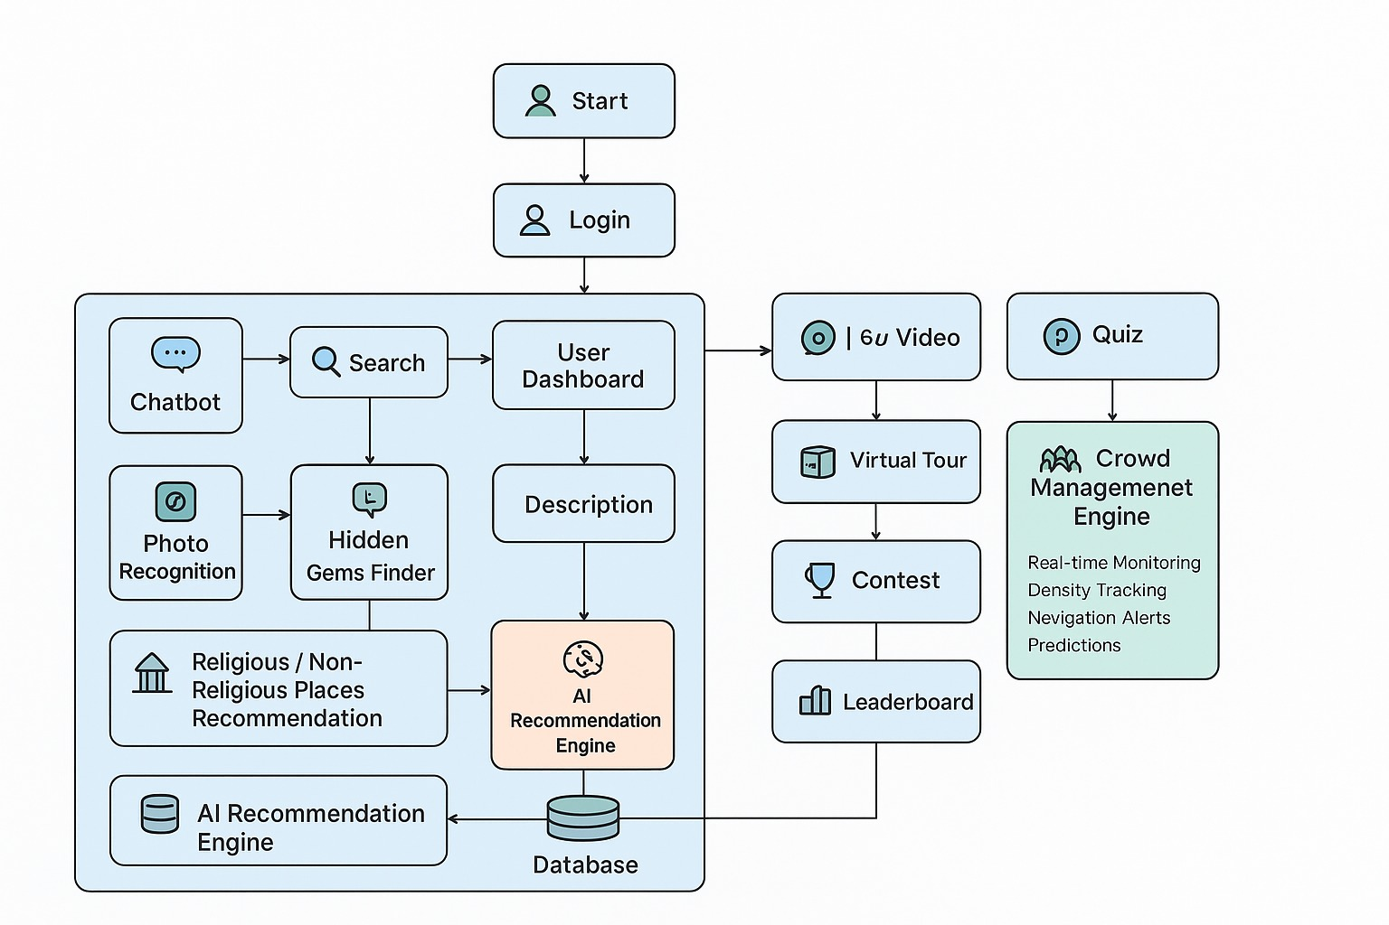

ARCHITECTURE DESIGN
TechStack
Technologies to be Used:
Frontend: HTML, CSS, JavaScript, React.js
Backend:Django
Data Source: Google Maps, Places API, openweatherapp and crowd API
Chatbot: Gemini API
Database: SQLite
Authenthication: Firebase
Methodology & Process for Implementation:
Modular web platform with dedicated AI sections: Photo Recognition, Travel Journey Designer, Hidden Gems (religious + non-religious).
Pre-trained/custom AI models for cultural/religious image recognition and personalization.
Real-time + sample datasets for attractions, businesses, events, temples, and heritage sites.
Continuous usability and scalability testing with multilingual support.

Slide 4
FEASIBILITY AND VIABILITY
TechStack
Feasibility:
Technical: Uses proven AI + cloud tech,modular for upgrades.
Operational: Accessible via web/mobile.
Financial: Low-to-moderate cost, scalable with partnerships and marketplace add-ons.
Challenges faced by users:
High expectations for AI-based recognition (religious + cultural).
Data accuracy for local businesses, events, and heritage listings.
Designing a universal, multilingual interface for all age groups.
Strategies to Overcome Challenges:
Use pre-trained AI models, open datasets, and cultural/religious APIs.
Communicate prototype limitations and roadmap clearly.
Build adaptive UI with accessibility + multilingual support.
Local artisans and businesses achieve better visibility and income.

Slide 5
IMPACT AND BENEFITS
TechStack
Potential Impact on Target Audience:
Tourists: Richer experiences by discovering both religious and non-religious heritage along with hidden gems.
Hotels/Restaurants: Increased bookings.
Local Businesses & Artisans: More visibility and income growth.
Tourism Industry: Encourages digital adoption and sustainable cultural promotion.
Benefits of the Solution:
Immersive, educational, and interactive journeys (religious + cultural).
AI-powered travel companion that is scalable and adaptive.
Promotes sustainable, responsible, and culturally rich tourism.

Slide 6
RESEARCH AND RESOURCES
TechStack
Smart Tourism: Foundations, Developments, and Directions – Zheng Xiang & Daniel Fesenmaier (2017) → Digital tech, AI & big data enable personalized travel.
Artificial Intelligence in Tourism: A Review – Buhalis & Leung (2018) → Role of chatbots, recommendation engines, personalization in tourism.
Crowd Management in Public Spaces – Wang et al. (2020) → Use of real-time monitoring, prediction & alerts for crowd control.
Role of Technological Transformation in Shaping Millennials’ Travel Behaviour: A Review – (2022) → Millennials demand mobile-first, authentic, experiential, and tech-integrated tourism.
Smart Tourism Technologies – A Key to Success and Survival for Sustainable Eco-tourism Development in Dooars Region (West Bengal) – (2023) → Highlights ICT adoption, eco-tourism, local empowerment, offline support & sustainability.

